Slide 1
DAA Project
By: Muhammad Bilal and Emaan Umer

Slide 2
Table of contents
01
02
03
04
Real-world Problem
Fourier Transform
Fast Fourier Transform
The Cooley-Tukey Algorithm

Slide 3
Table of contents
05
06
Real-world application
Final Remarks

Slide 4
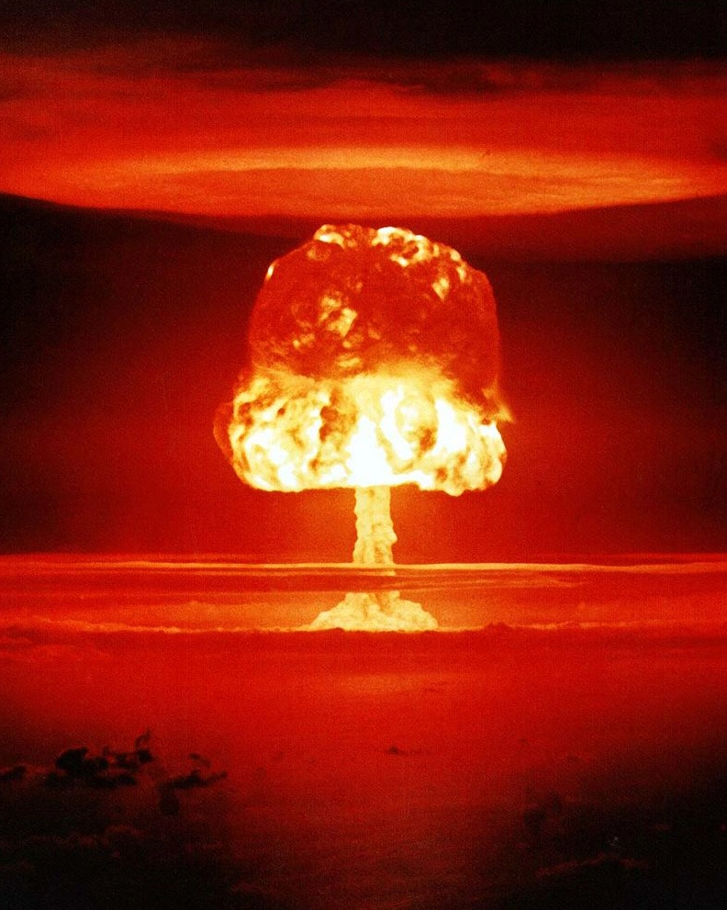
Ka-boom!
A universal disaster, waiting to happen

Slide 5
01
Real world problem
Detection of underground nuclear explosions

Slide 6
Some background…
Nuclear testing refers to the process of detonating nuclear weapons to study their effects and capabilities.
This type of testing began during World War II and continued throughout the Cold War era.
There are two main types of nuclear testing:
Atmospheric Testing | Underground Testing
It involves detonating a nuclear device above ground | It involves detonating a device in a deep underground tunnel.

Slide 7
Our concern: Underground nuclear explosions
Problem
Solution
Seismic sensors measure ground motion and vibration.
Data is collected and processed in real-time.
Advanced signal processing algorithms are applied.
Signal processing algorithms can differentiate between natural events and explosions.
The algorithms can detect low-yield explosions.
Seismic monitoring networks can be used to detect multiple explosions.
Detection using signaling algorithms is crucial for international treaty monitoring.
Seismic waves attenuate in the earth
Waves can disperse, reflect, and refract
Boreholes or tunnels contain explosions
Explosion containment reduces seismic energy
Natural events produce similar signals
Advanced technologies further reduce seismic signature
Detection is critical for international treaties

Slide 8
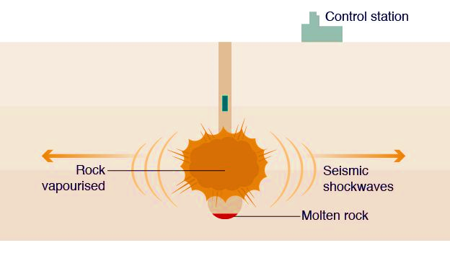
Underground explosions going under the radar
The Partial Test Ban Treaty (PTBT) was signed in 1963 by the United States, the Soviet Union, and the United Kingdom.
The treaty banned nuclear testing in the atmosphere, outer space, and underwater, but it did not prohibit underground nuclear testing.
At the time of the PTBT's signing, underground nuclear testing was
considered to be less hazardous, and negotiators believed that
underground testing could be effectively monitored for compliance.
However, detecting underground nuclear explosions is challenging,
and the monitoring technologies at the time were not sufficient to
detect underground tests reliably.

Slide 9
Any solution?

Slide 10
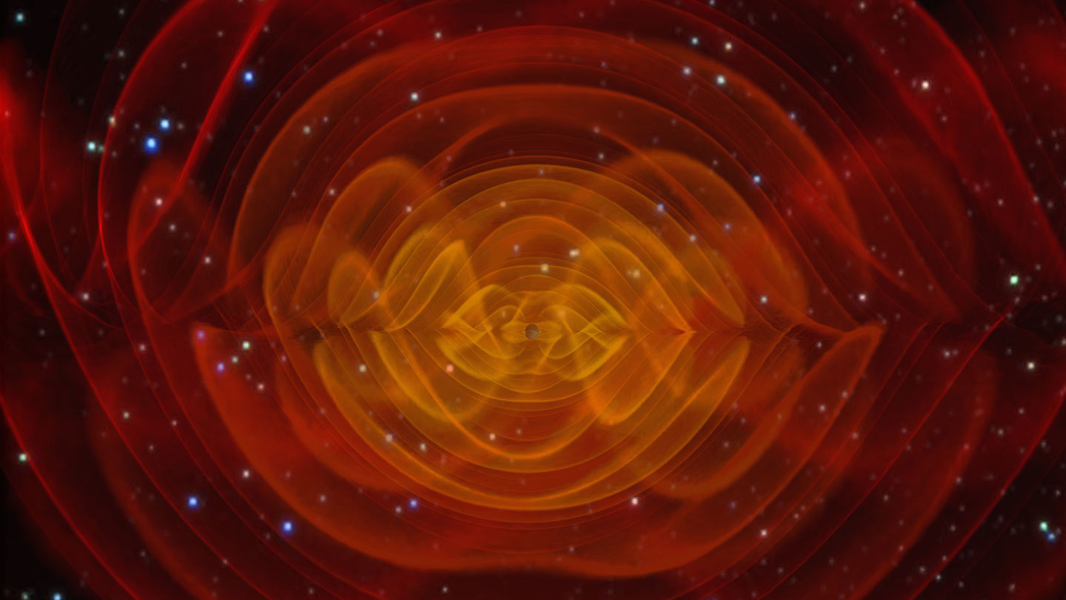
An algorithm that dictates everything in the universe

Slide 11
02
Fourier transform
A waveform's essence the Fourier does show,
with frequency domain, insights start to flow.

Slide 12
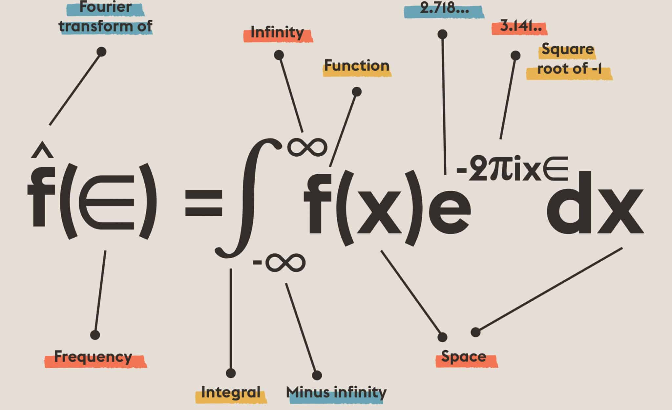
From Time to Frequency: Unveiling the Beauty of Signals!
The Fourier transform converts signals in the time domain to the frequency domain.
It breaks down a complex waveform into simpler sine and cosine waves.

Slide 13
—Muhammad Bilal
“Integration requires continuity, and continuity is a menace to practicality.”

Slide 14
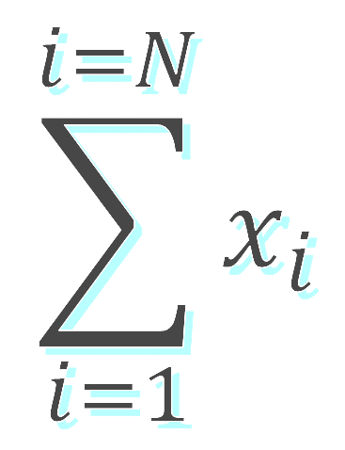
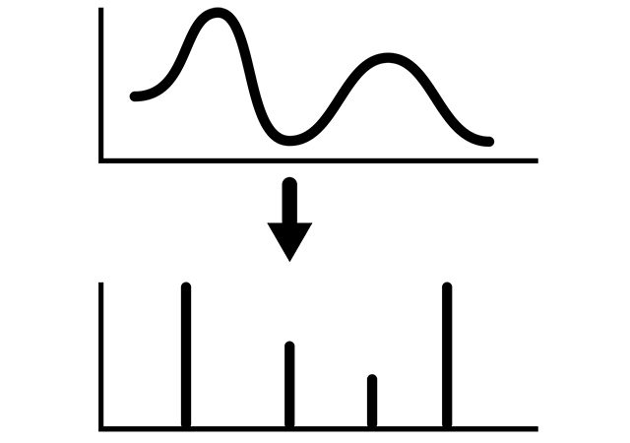
Discretization of Integration for Finite Data Points

Slide 15
The DFT: a viable solution?
Accurate Conversion to Frequency Domain
Detects Low-Frequency Signals
Computationally Efficient
The Discrete Fourier Transform can reveal specific patterns and characteristics associated with underground nuclear explosions in the frequency domain
The Discrete Fourier Transform can identify low-frequency signals that may be present in the seismic waves generated by an underground nuclear explosion but may be difficult to detect using traditional methods.
The Discrete Fourier Transform allows for the analysis of large datasets in real-time, which is crucial for detecting underground nuclear explosions in a timely and accurate manner.

Slide 16
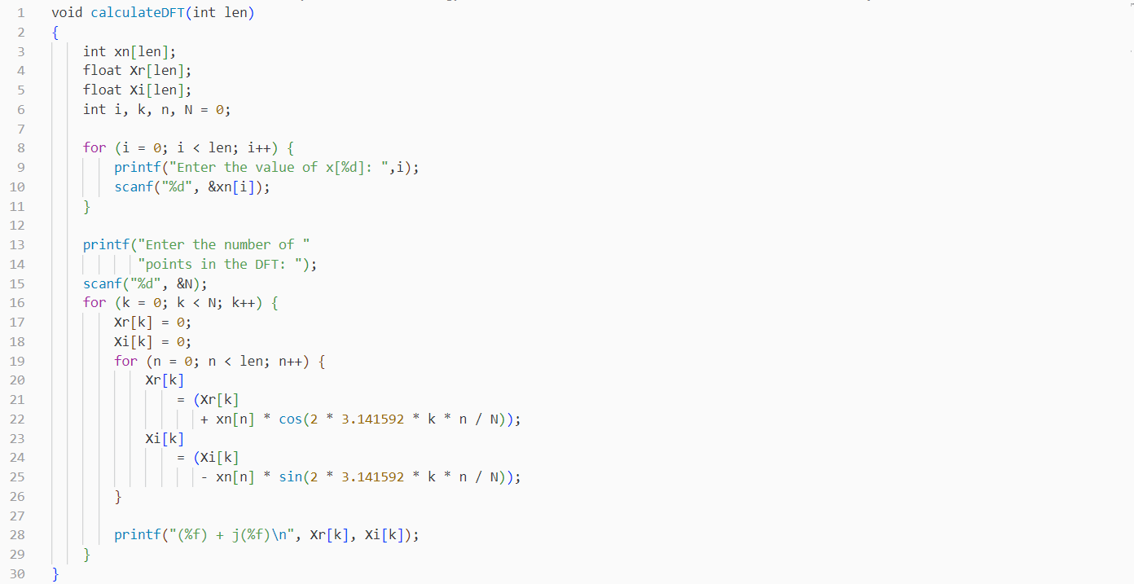
The Discrete Fourier Transform
Algorithm Design

Slide 17
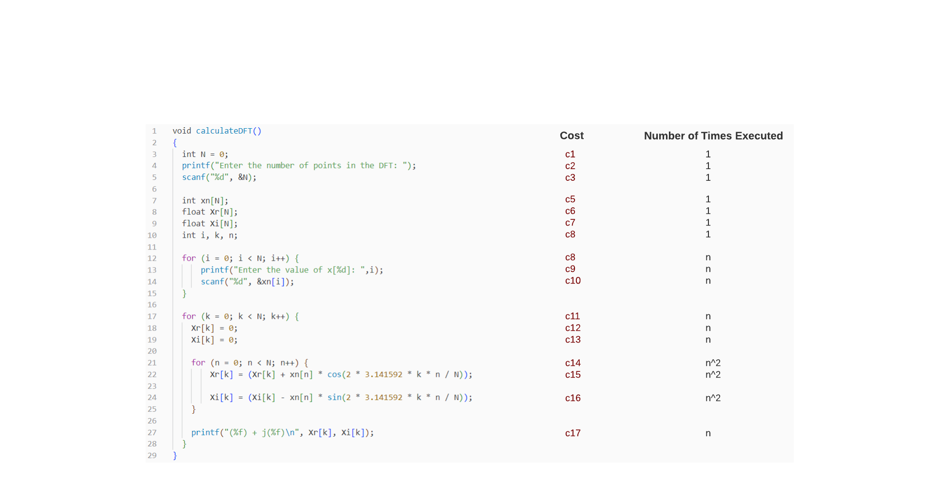
The Discrete Fourier Transform
Algorithm Analysis

Slide 18
O(n^2)
Every algorithm’s worst nightmare

Slide 19
To put things into perspective
Start DFT
End DFT
…Detect Explosion

Slide 20
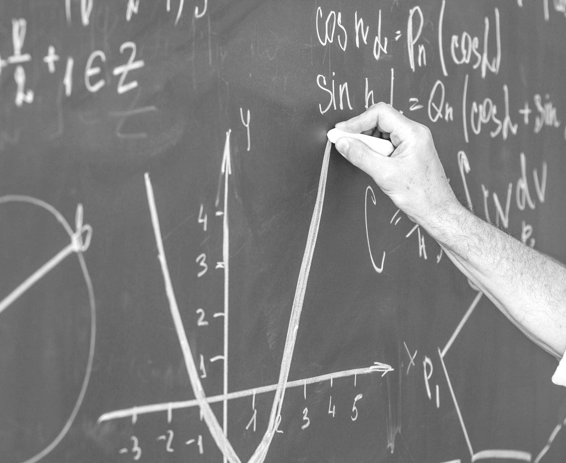
Could we do something about it?
Nature's beauty lies in its symmetry, Mirrored patterns, perfect harmony.

Slide 21
The Fast Fourier Transform (FFT)
03
A better alternative for DFT computation

Slide 22
The FFT
efficient algorithm for computing the Discrete Fourier Transform (DFT) and its inverse.
exploits symmetric and periodic properties of the Fourier Transform to reduce the computational complexity.
uses a divide-and-conquer approach, recursively splitting the signal into smaller parts and combining the results efficiently to obtain the final Fourier Transform.
has several variations, such as Radix-2, Radix-4, and Cooley-Tukey algorithm

Slide 23
Symmetry in complexity?

Slide 24
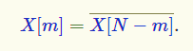
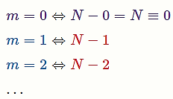
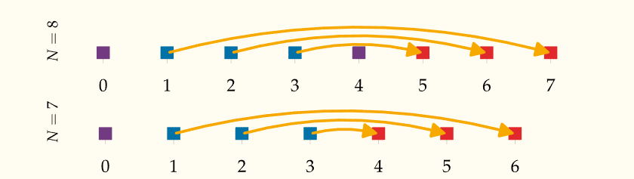
Complex conjugate symmetry
If x[n] is a real-valued signal with N samples. Then, the DFT series X[0],X[1],……, X[N-1] has conjugate symmetry:
So if N has the following values:

Slide 25
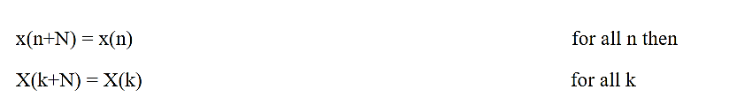
Periodic symmetry
If x[n] and x[k] are a N point DFT pair, then:

Slide 26
From DFT to FFT
Just follow a series of steps!

Slide 27
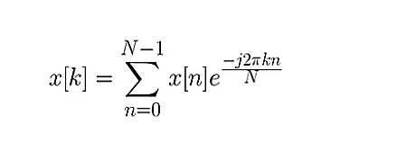
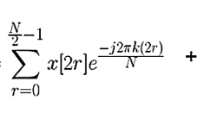
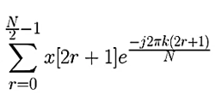
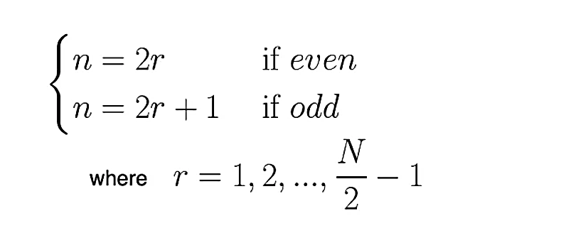
Step 1: Take your DFT function and split it into odd and even subsequences
This is your DFT function of size N
This is your DFT function of size N with N/2 odd and even summations
If we separate all the odd and even samples using this:
Separating and substituting this in:

Slide 28
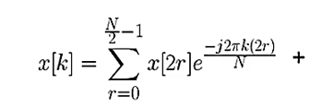
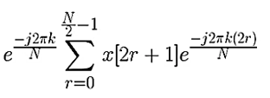
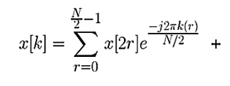
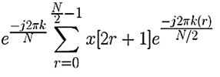
Step 2: Simplify the function
A twiddle factor appears with the odd function
Making coefficient of r the denominator of N:

Slide 29
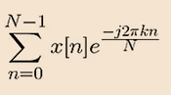
Step 2: Simplify the function
A DFT of size n/2 containing odd samples
A DFT of size n
A DFT of size n/2 containing even samples
where:
What if we kept on splitting?

Slide 30
Step 3: Recursively split your DFTs until there are N 1-point DFTs
You then perform complex multiplications and additions to combine the results that finally form your N DFT signal.
The algorithm for these mathematical calculations is known as the Cooley-Tukey Algorithm

Slide 31
The Cooley-Tukey Algorithm
04
.

Slide 32
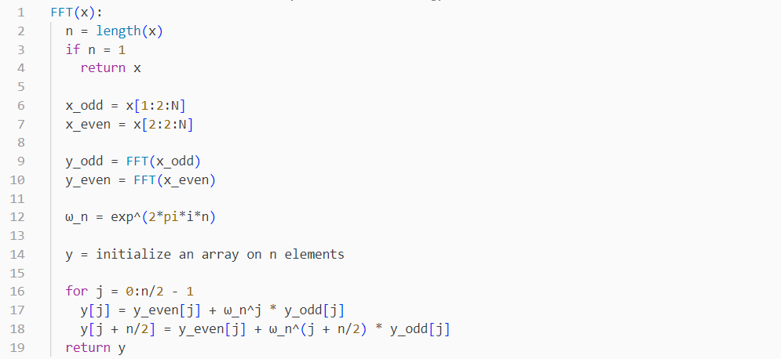
The Cooley-Tukey Algorithm
Algorithm Design

Slide 33
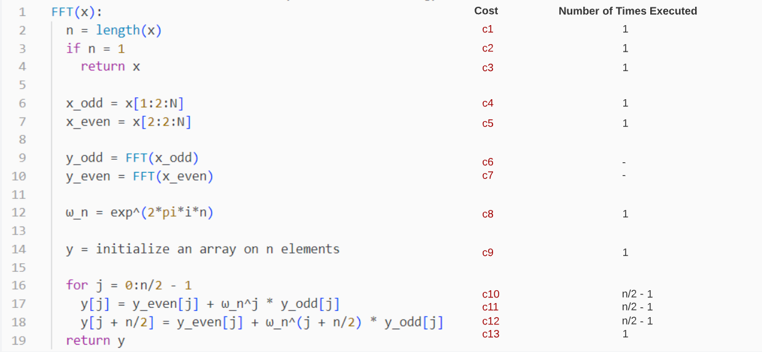
The Cooley-Tukey Algorithm
Algorithm Analysis

Slide 34
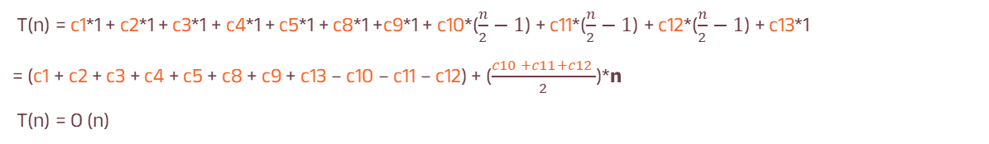
The Cooley-Tukey Algorithm
Algorithm Analysis
To find the non-recursive part:
T(n) = c1*1 + c2*1 + c3*1 + c4*1 + c5*1 + c8*1 +c9*1 + c10*($\frac{n}{2}−1$) + c11*($\frac{n}{2}−1$) + c12*($\frac{n}{2}−1$) + c13*1
= (c1 + c2 + c3 + c4 + c5 + c8 + c9 + c13 – c10 – c11 – c12) + ($\frac{c10 +c11+c12 }{2}$)*n
T(n) = O (n)

Slide 35
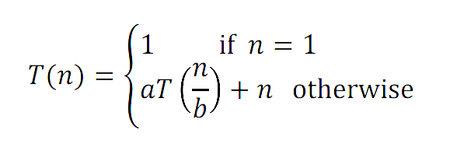
The Cooley-Tukey Algorithm
Algorithm Analysis
To find the recursive part:
Since the algorithm is recursive, hence, the following format will apply:
a: is the number of times the function calls itself
b: is the factor by which the input size is reduced.
f(n): is the complexity of the non-recursive part.

Slide 36
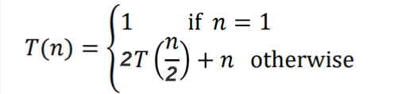
The Cooley-Tukey Algorithm
Algorithm Analysis
To find the recursive part:
We know that the function is split into two recursive calls (one each for odd and even).
So number of recursive calls = a = 2
We know that the size of our problem divides by half at each call
So, size of our sub-problem = b = 2
Our recurrence relation:

Slide 37
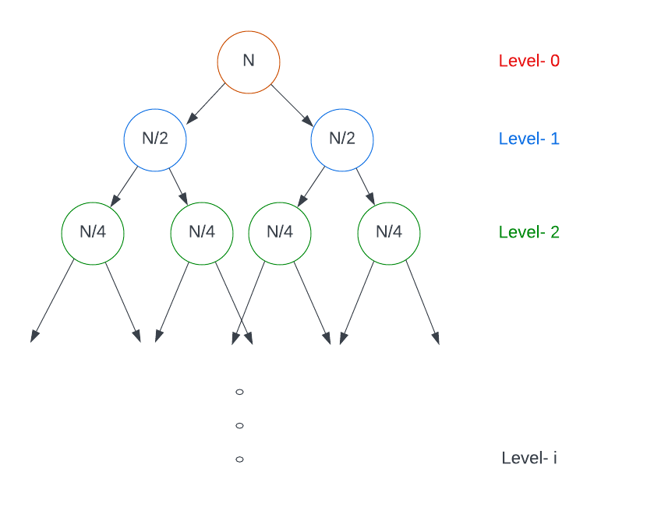
The Cooley-Tukey Algorithm
Algorithm Analysis
Solving the relation using the recursion tree:
COST OF EACH LEVEL
Cost of level-0 = n
Cost of level-1 = n/2 + n/2 = n
Cost of level-2 = n/4 + n/4 + n/4 + n/4 = n
…and so on.
TOTAL NUMBER OF LEVELS IN THE TREE
Size of sub-problem at level-0 = n/2⁰
Size of sub-problem at level-1 = n/2
Size of sub-problem at level-2 = n/2²
.
.
Size of sub-problem at level-i = n/2ⁱ

Slide 38
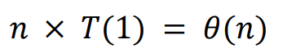
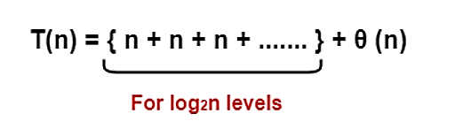
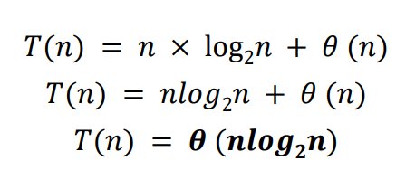
The Cooley-Tukey Algorithm
Algorithm Analysis
Solving the relation using the recursion tree:
At the last level the size of the sub-problem becomes 1, then
n/2ⁱ = 1
We now get i = log2n
This means level-i or level-log2n has 2log2n nodes or n nodes
We then find cost of last level as :
Adding the cost of all levels in the recursion tree and simplifying it, we get our complexity as:

Slide 39
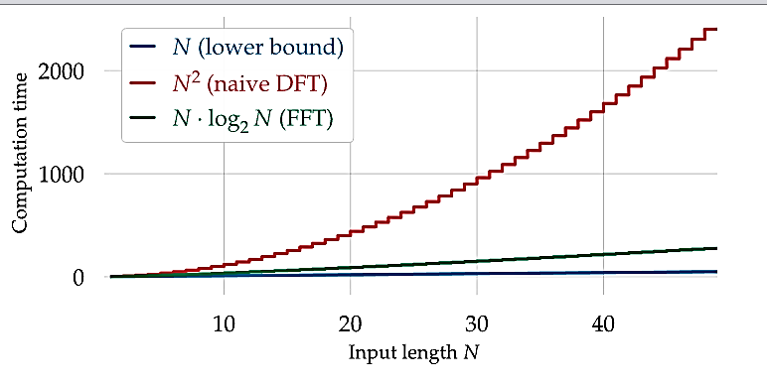
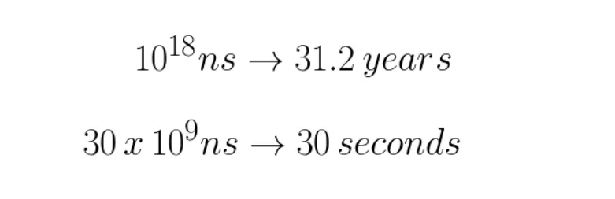
Difference In Both Complexities
 | N = 10³ | N = 10⁶ | N = 10⁹
N² | 10⁶ | 10^12 | 10^18
NlogN | 10⁴ | 20 * 10^6 | 30 * 10^9

Slide 40
Applying it to our real-world problem
05

Slide 41
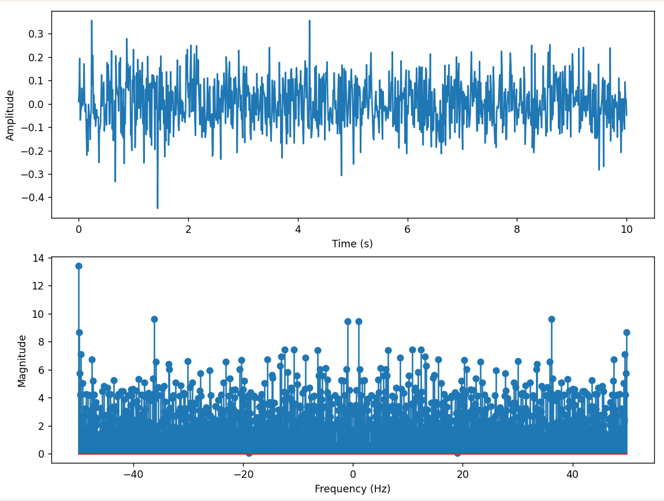
Python Code for Wave Generation
We used code that generates two distinct waveforms: one containing nuclear activity and one does not.
The results are shown as follows:
No Nuclear Activity present:

Slide 42
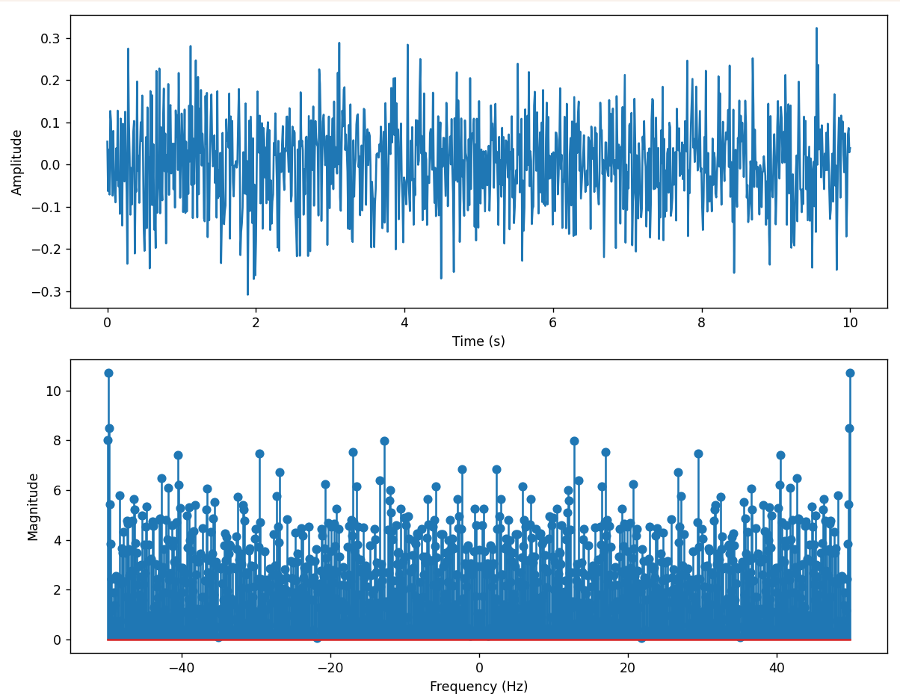
Python Code for Wave Generation
Nuclear Activity present:
High-frequency components are present in this graph

Slide 43
06
Final Remarks
What did we take away?

Slide 44
Achievement & Effort
Problems Encountered
Developed and optimised an algorithm with O(NlogN) compexity, contributing significantly to signal processing
Faced challenges in data quality, algorithm optimization, signal processing complexity, and graphical visualization
Comments
Future Works
Achieved the goal of creating an accurate algorithm which could be broadened to cover a range of real-world occurences. Data uncertainty not addressed
Expand to cover wider range of real-world phenomena
Incorporate uncertainty quantification
Validate algorithm's effectiveness in scenarios
Identify areas for improvement

Slide 45
For Conjugate Symmetry: link 2017 North Korean Nuclear Test: link Nuclear Weapons Test Articles: link Fast Fourier Transforms Background: link Fast Fourier Transform Math: link Discrete Fourier Transform: link Discrete Fourier Transforms in Signal Processing: link
References

